Slide 1
SOC Final Project Group 3: Drone-Aided Police Control System
Group Member:
工科所 109011566 楊智勝
資工所 111062656 許芷毓
交大電信所 0007-310513008 楊士緯
電機系 108061181 郭義安
光電所 110066534 陳俊翰

Slide 2
Outline
Introduction
System Architecture
Specification and Technology Analysis
Drone system
Camera - Electronic Image Stabilization (EIS)
AI algorithm
Edge server
Industrial Analysis
Porter’s 5 force analysis
S.W.O.T analysis
Conclusion
Task Partition
References

Slide 3
Outline
Introduction
System Architecture
Specification and Technology Analysis
Drone system
Camera - Electronic Image Stabilization (EIS)
AI algorithm
Edge server
Industrial Analysis
Porter’s 5 force analysis
S.W.O.T analysis
Conclusion
Task Partition
References

Slide 4
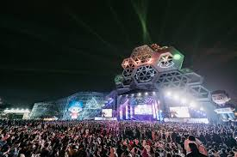
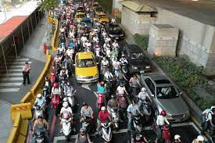
Introduction
We propose a drone-aided police control system, which assist the police for real-time surveillance on big events
Target market
Police, event host, telecom operator (CHT, FET, TWM)
Application scenarios
Concert, new year eve’s party, baseball game
Traffic jam during commute time

Slide 5
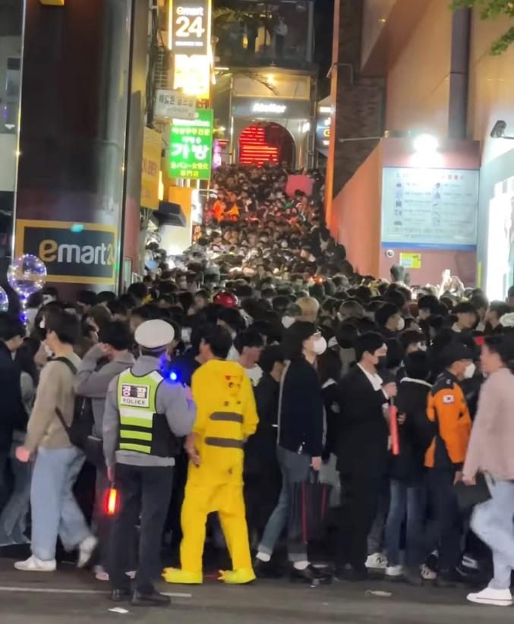
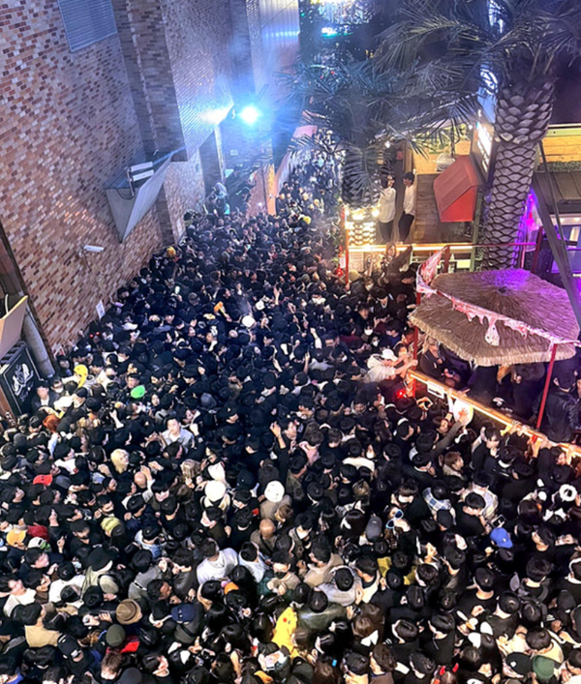
Motivation
Itaewon crowd crush (梨泰院)
It’s difficult for the police to rescue since the space is full people
To prevent the tragedy happens again
We aim to propose a framework provide a better efficiency to evacuate crowd

Slide 6
Outline
Introduction
System Architecture
Specification and Technology Analysis
Drone system
Camera - Electronic Image Stabilization (EIS)
AI algorithm
Edge server
Industrial Analysis
Porter’s 5 force analysis
S.W.O.T analysis
Conclusion
Task Partition
References

Slide 7
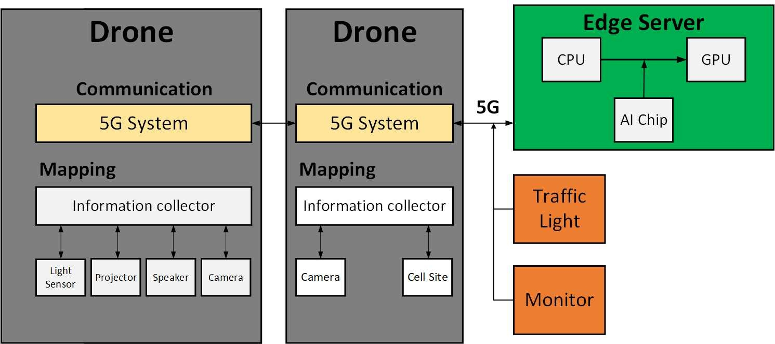
System Architecture

Slide 8

Data Flow
Drone with LED & speaker
Edge server
Crowd density recognition
Traffic analyze
Drones management
Traffic light
Drone with projector & speaker
Control signal
GPS data
Video data
Control signal
Monitor
Warning message
Drone with 5G small cell
GPS, Video, and RSS data

Slide 9
Outline
Introduction
System Architecture
Specification and Technology Analysis
Drone system
Camera - Electronic Image Stabilization (EIS)
AI algorithm
Edge server
Industrial Analysis
Porter’s 5 force analysis
S.W.O.T analysis
Conclusion
Task Partition
References

Slide 10
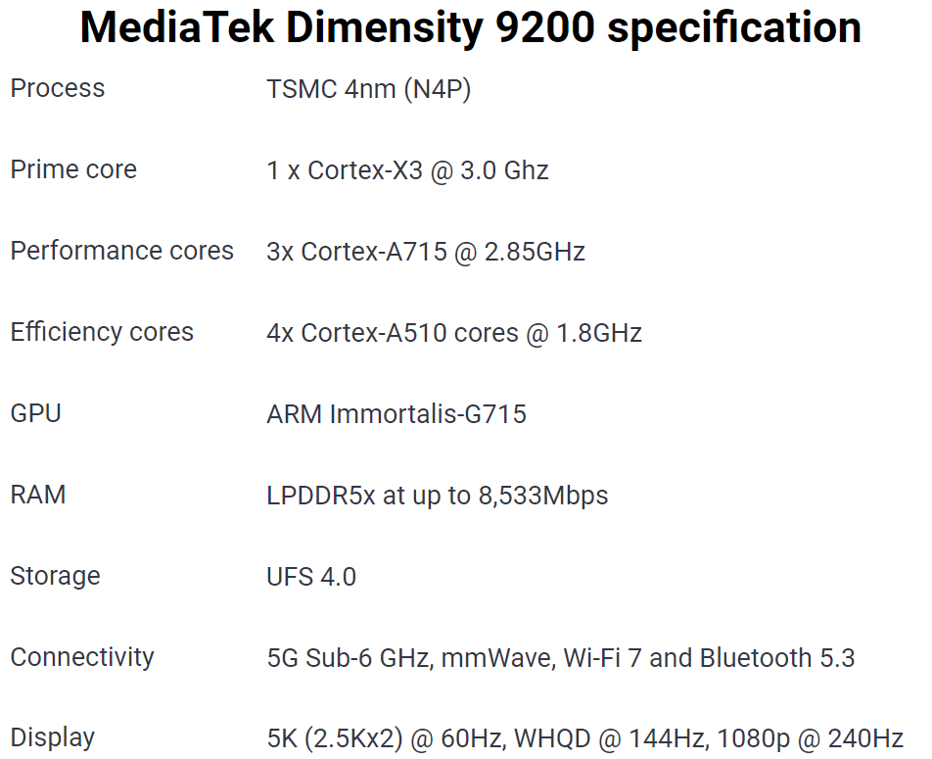
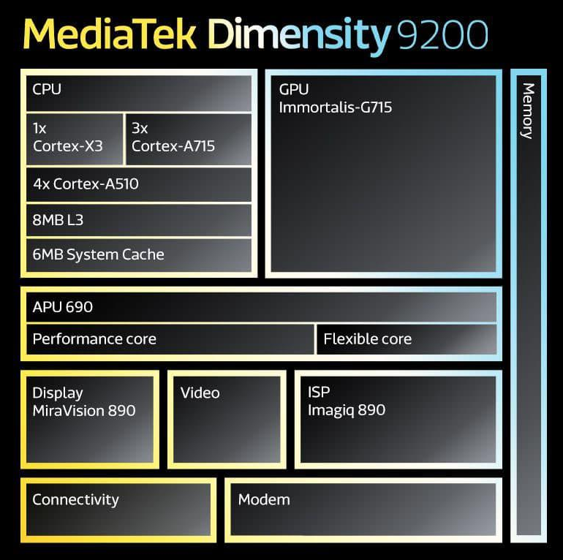
Drone System (1/10)
SoC specification
We adopt the 5G solution from Mediatek
MediaTek Dimensity 9200
Camera
CMOS sensor: 1/1.2 inch, 12MP
Angle of view: 82.1 degree
Aperture: f/1.7

Slide 11
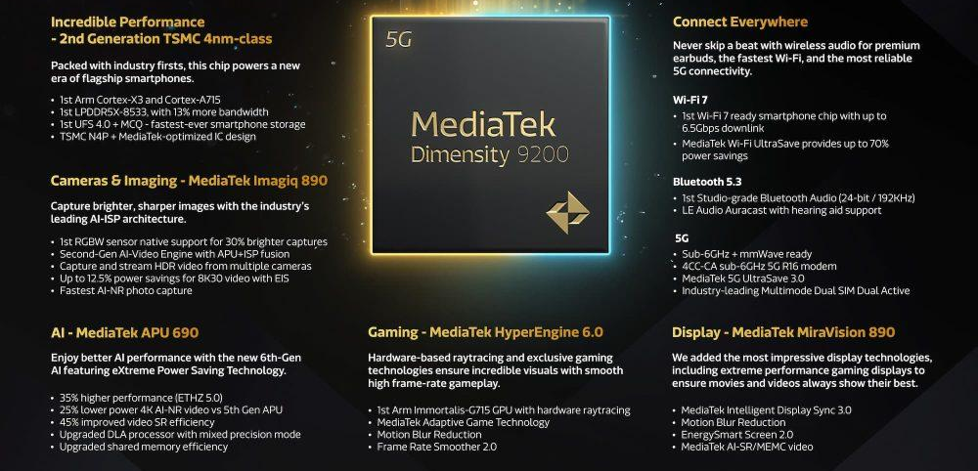
Drone System (2/10)
5G radio band: 4.4GHz ~ 4.7 GHz
This frequency band is exclusive to the police
MediaTek Dimensity 9200’s powerful performance ensure the quality of videos
Its cutting-edge display technology supports FHD+ up to 240Hz
MediaTek AI-SR/MEMC provides best-in-class video streaming

Slide 12
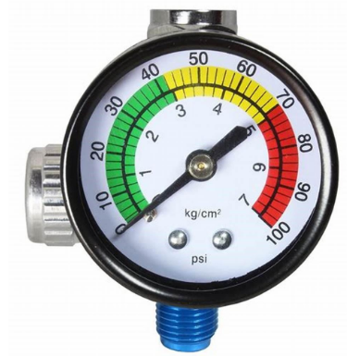
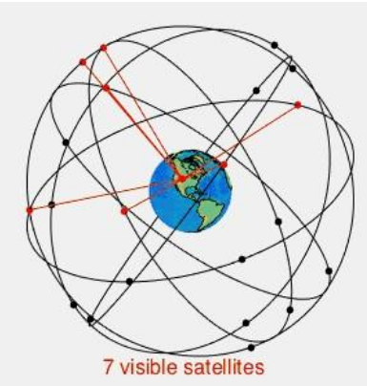

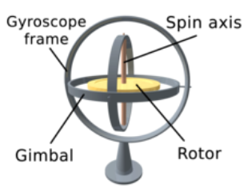
Drone System (3/10)
Sensors
Gyroscope
Calculate the tilt angle of the body and is an indispensable sensor stabilizing
Barometer
Sense the relative and absolute height of an object through changes in air pressure
Accelerometer
Sense the magnitude and direction of combined linear and gravitational acceleration
GPS
Magnetic field orientation sensor (magnetometer or compass)
Sense the earth's magnetic field (geomagnetism), so as to know the direction of the drone face to
Notes:
Introduction of drone sensors

Slide 13
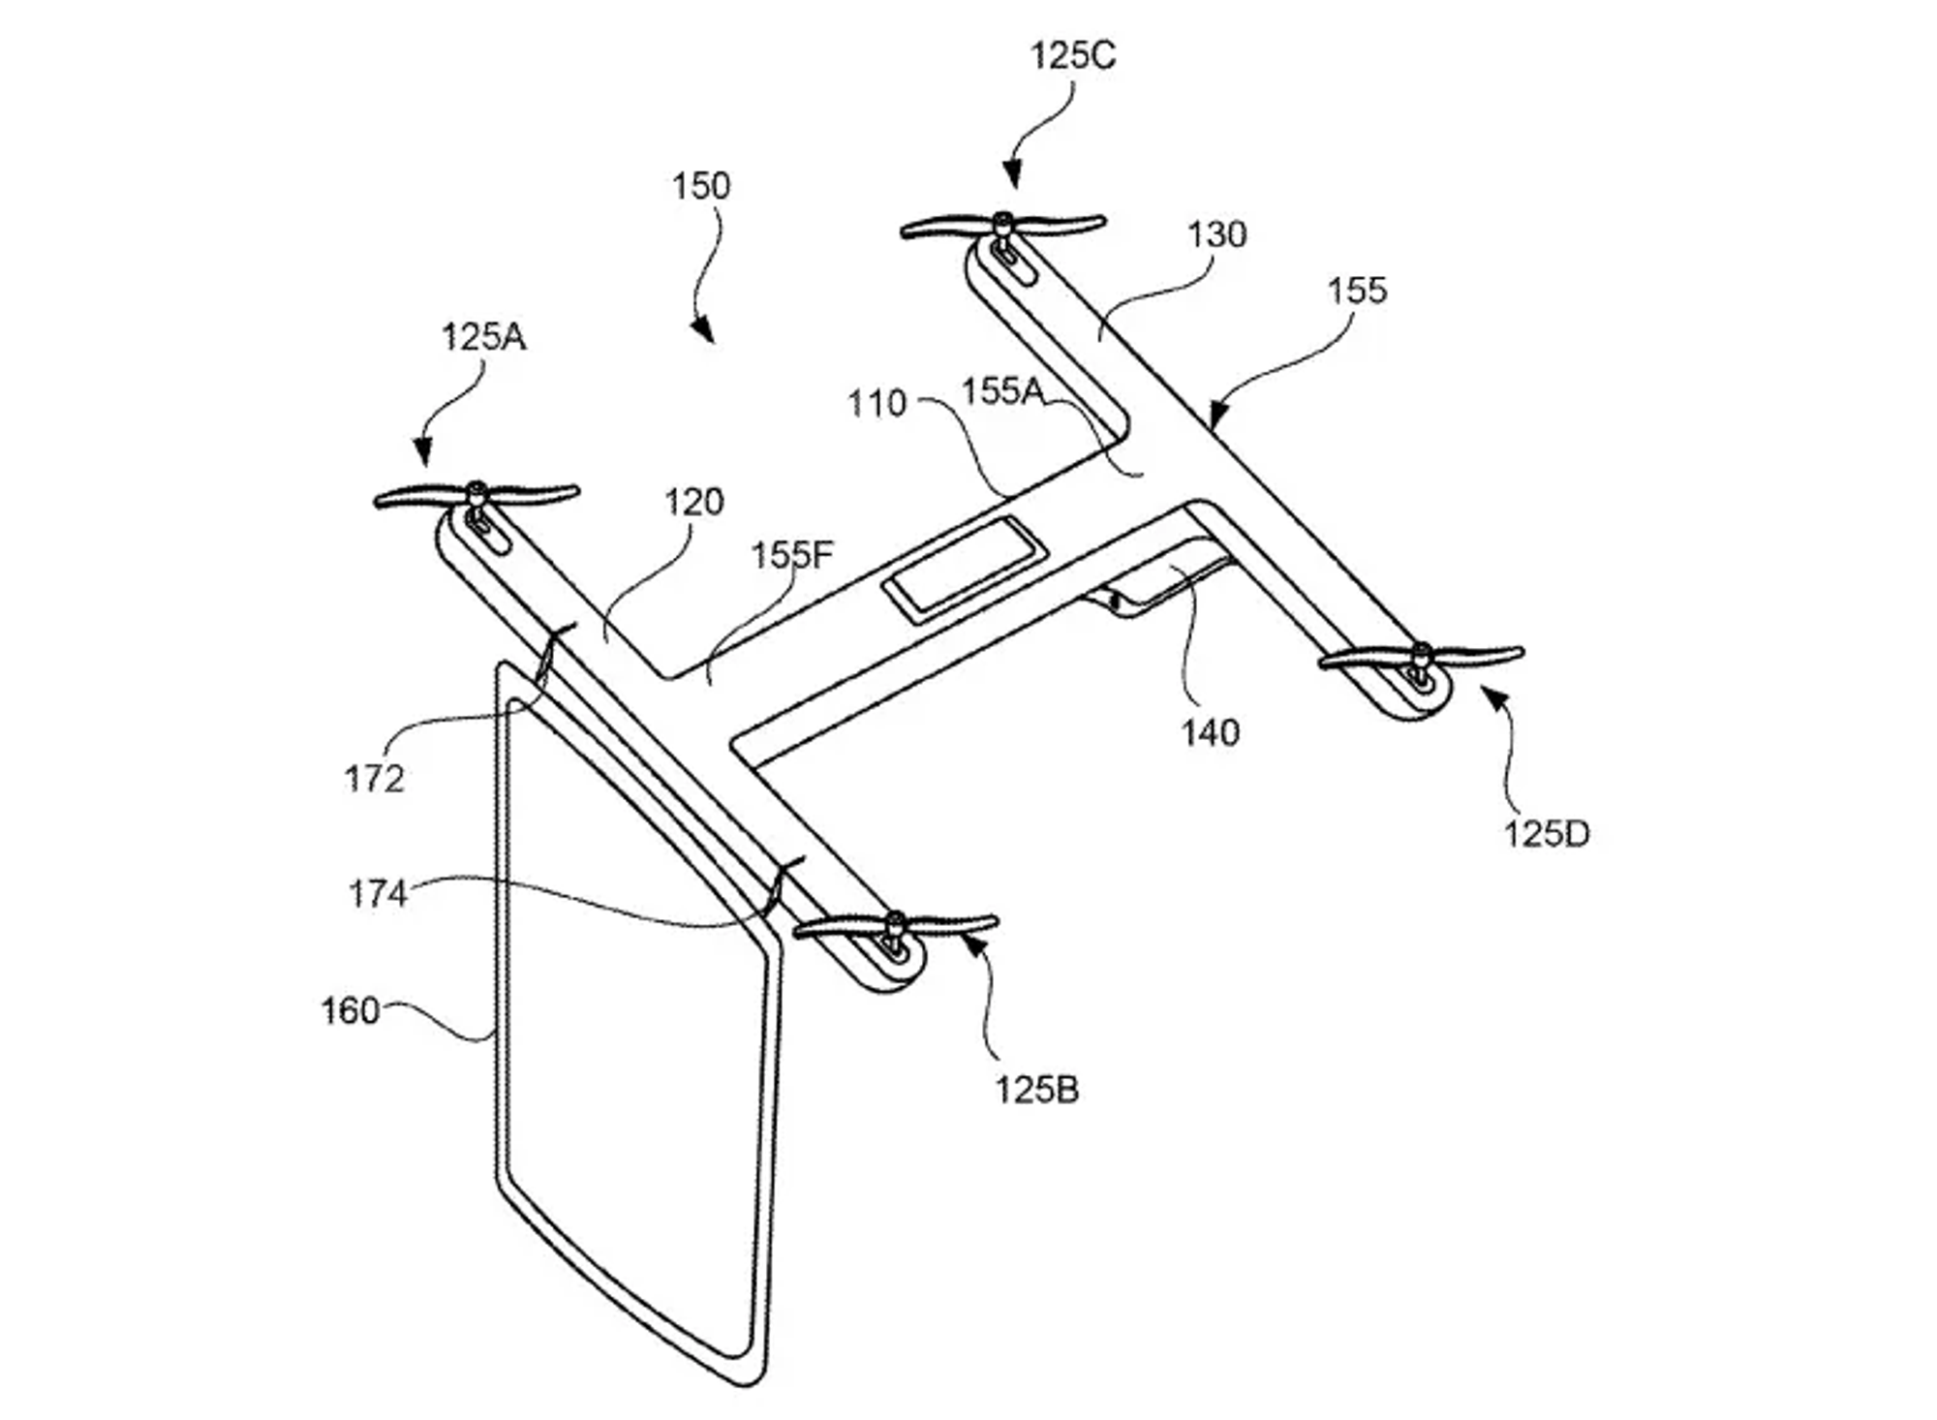
Drone System (4/10)
Consists of three kinds of drone
Drone equipped with projector, flash light, speaker, and 5G small cell, respectively
Projector
Inspired by the Google patent – placing a screen on a drone
We placed a outdoor projector screen rather than a screen
To reduce the loading of the drone
We adopt the product from Elite Screens
The Yard Master Electric
Product features
Designed for outdoor use without compromising its home theater visual appeal
Wide diffusion uniformity allows viewers to enjoy a clear and bright picture from any angle

Slide 14
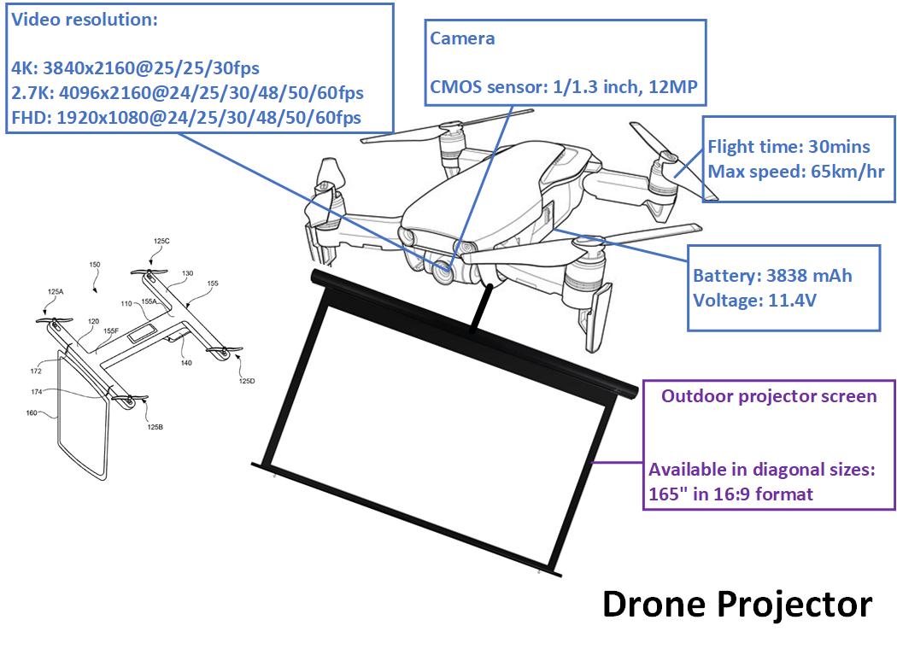

Drone System (5/10)
The screen provide the information to evacuate

Slide 15
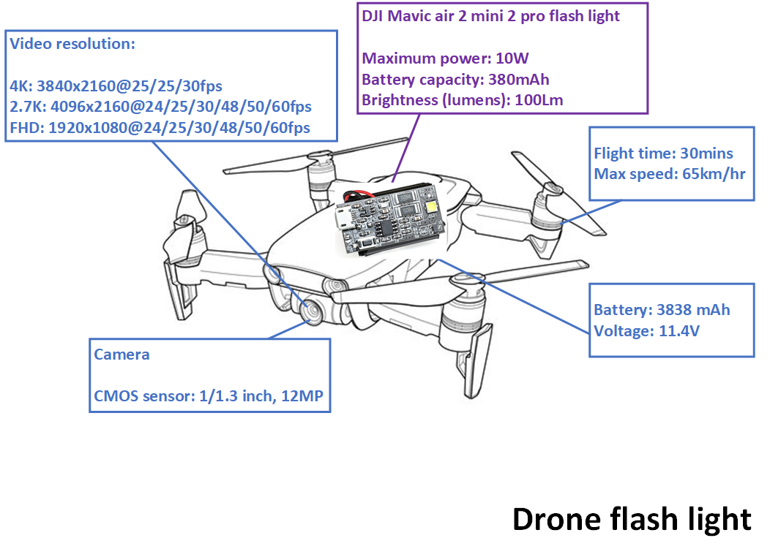
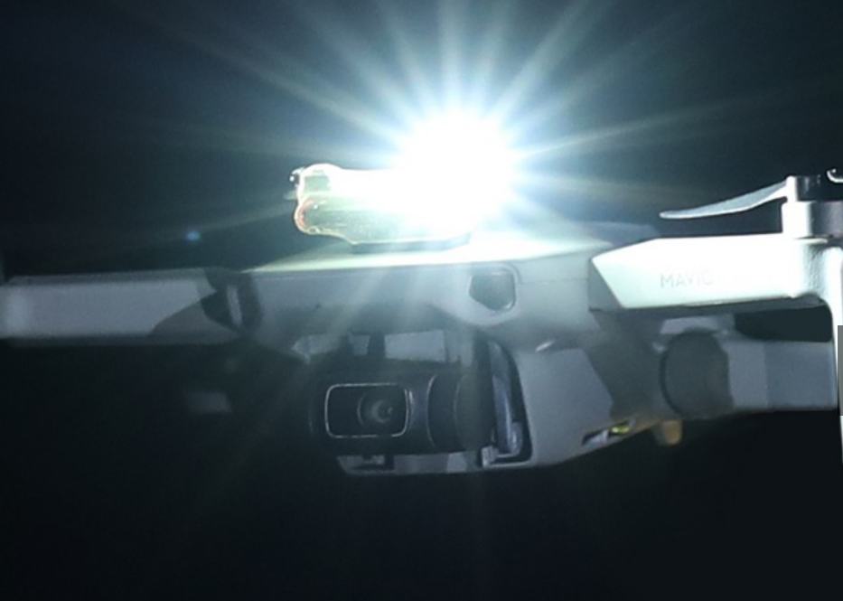
Drone System (6/10)
Flash Light
DJI Mavic air 2 mini pro flash light
Maximum power: 10 W
Battery Capacity: 380 mAh
Working time:
Single flash: 6h
Dual flash: 3h
Brightness (lumens): 1000 Lm

Slide 16
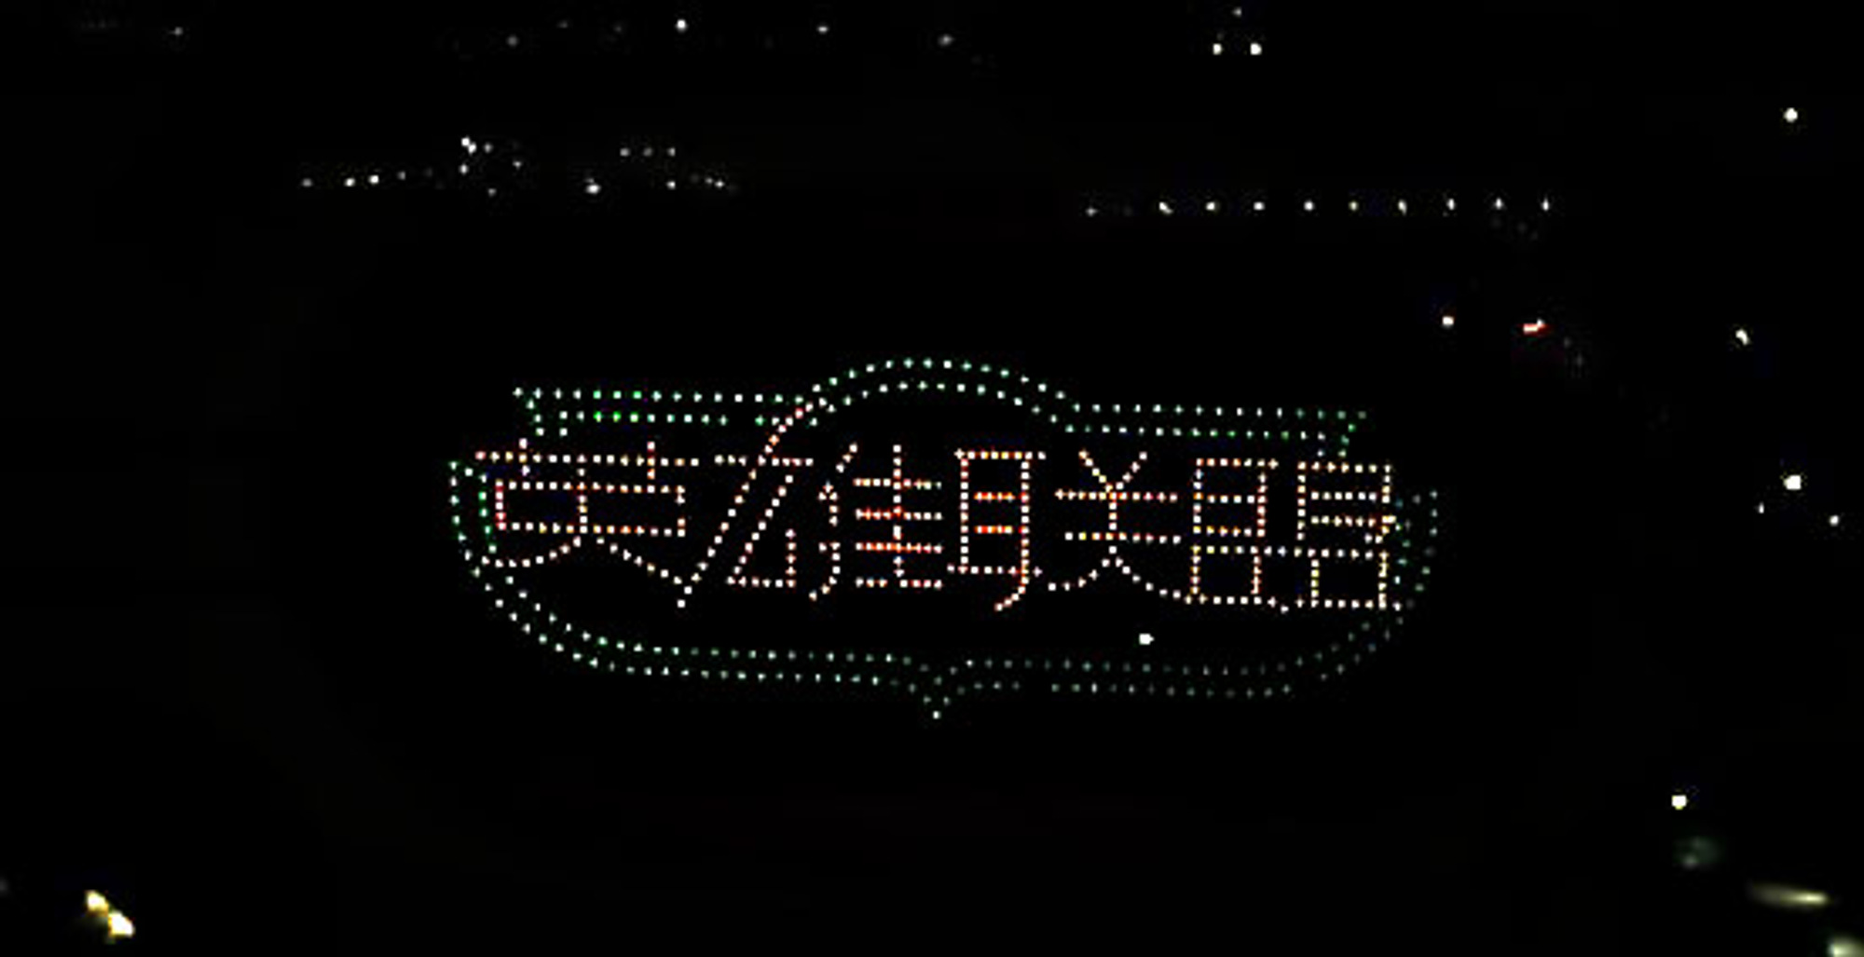
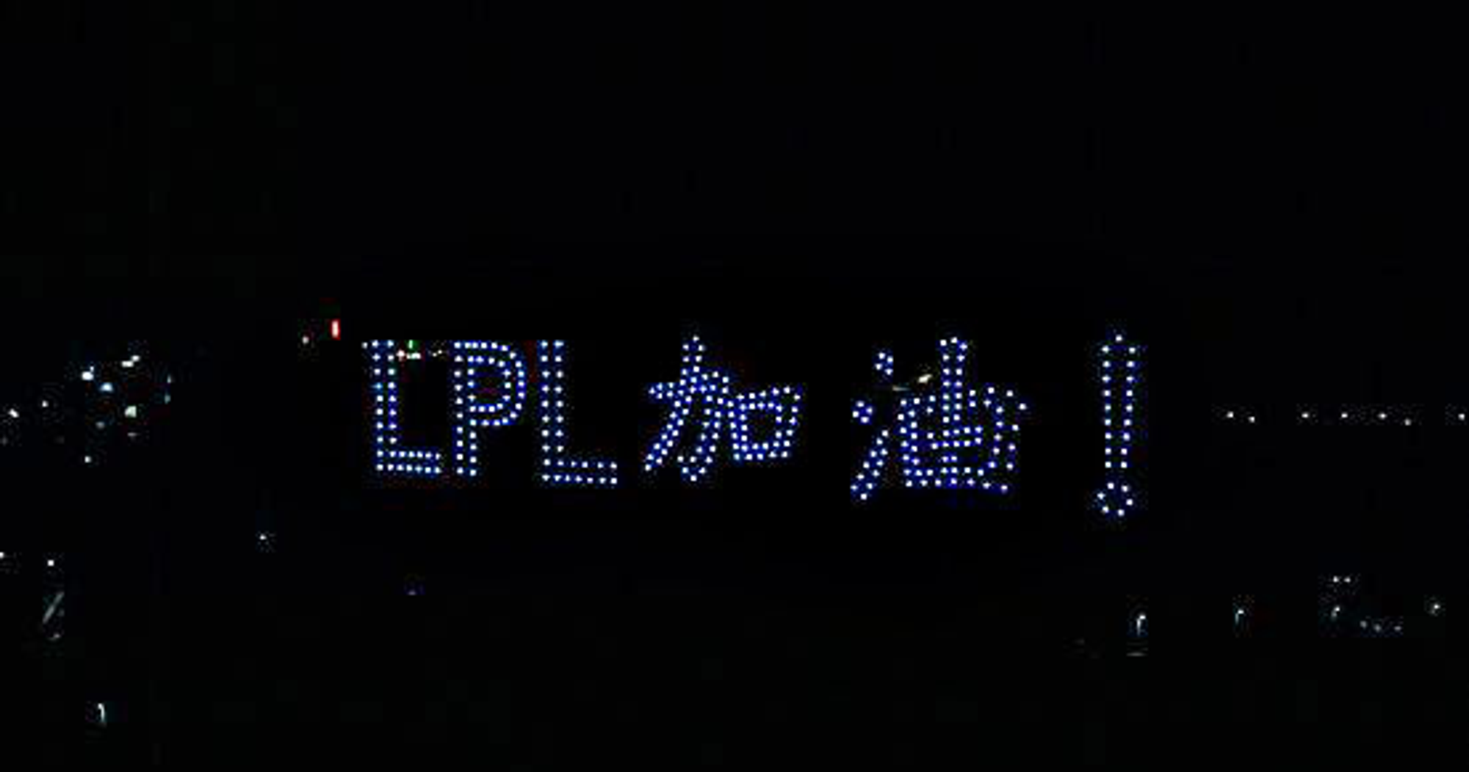
Drone System (7/10)
Combine multiple drone’s LED to generate different pattern
Simp4live Records (a musical group)
Specializing in light sculpture shows
The pattern generate by the drones can guide the crowd where to evacuation
E.g., form an arrow shape to navigate the direction

Slide 17
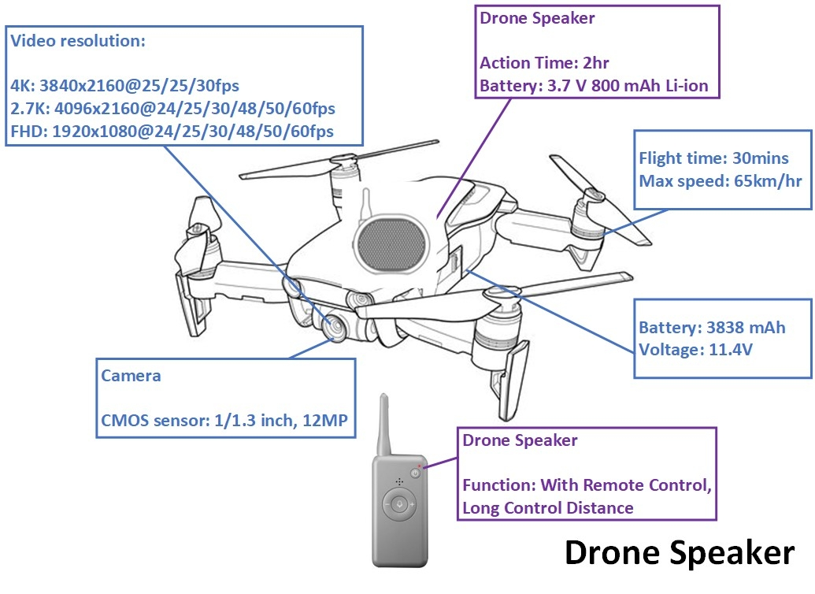
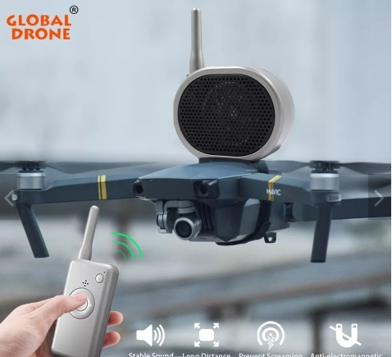
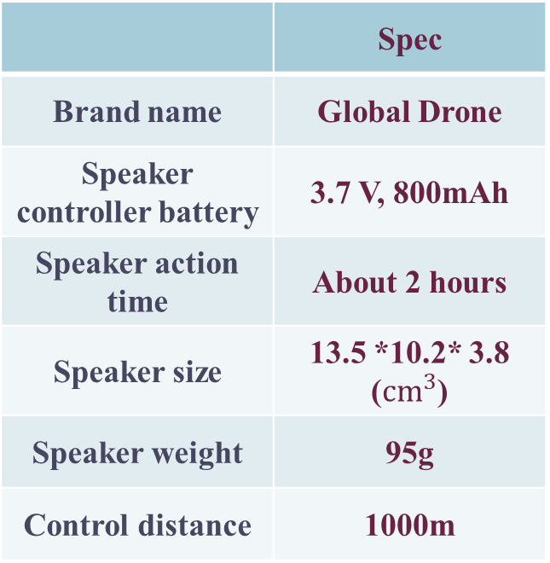
Drone System (8/10)
Speaker Specification
 | Spec
Brand name | Global Drone
Speaker controller battery | 3.7 V, 800mAh
Speaker action time | About 2 hours
Speaker size | 13.5 *10.2* 3.8 ($cm^{3}$)
Speaker weight | 95g
Control distance | 1000m

Slide 18
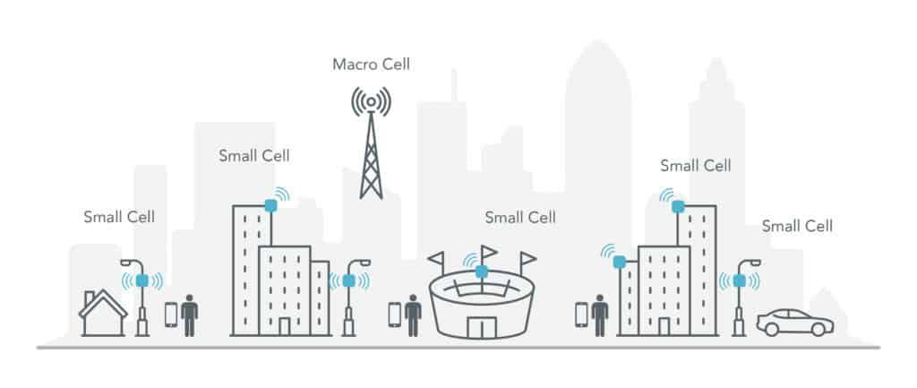
Drone System (9/10)
5G Small Cell
Due to the physical characteristic of high frequency signal and the demand of 5G signal
It is necessary to extend the signal coverage for 5G network to achieve low latency, high data rate
Small cell is a major feature for 5G network
To deal with the short communication range of 5G network
It enables network to extend coverage and to deliver low latency

Slide 19
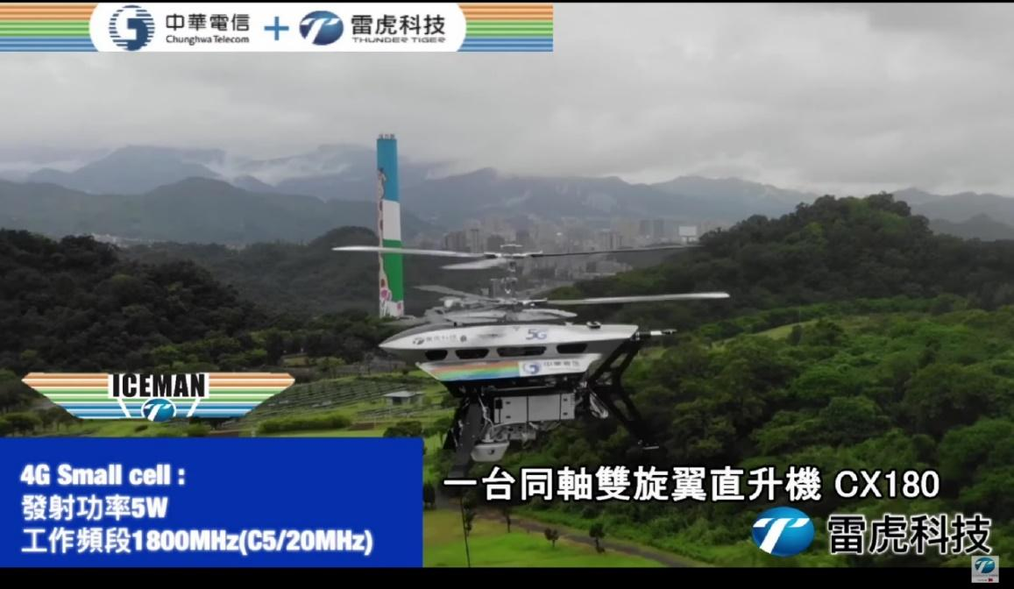
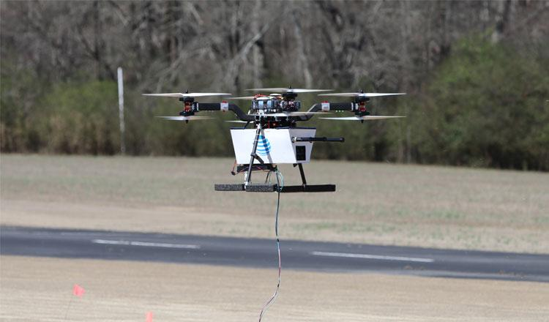
Drone System (10/10)
Cell on Wings (COW) – Flying COW
Increase the coverage of mobile signal from the sky
AT&T launched their COW technology in 2022 – 5G Flying COWs
The drones with a tether to the ground that provides power and fiber optic cable to broadcast data
Chunghwa Telecom (CHT) and THUNDER TIGER have proposed COW application

Slide 20
Camera - Electronic Image Stabilization (EIS) (1/2)
An image enhancement technique that effectively adjusts and balances the captured image
The system includes a sensor integrated into the camera
Reducing jittering and capturing the best stable photos
EIS incorporates two techniques to make the image stable
It digitally zooms in to capture a more prominent image
It corporates a larger sensor to resize the image to fit the available space (hardware-based)
Compare with the optical image stabilization (OIS) method
EIS has a better stabilize performance
EIS keeps improving the appearance through equal shifting, whereas the gimbal stabilizer works only drone has shifted

Slide 21
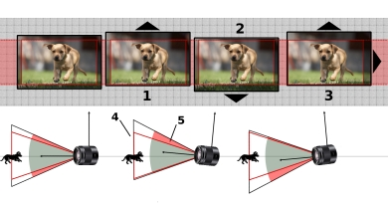
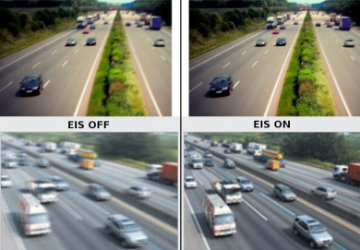
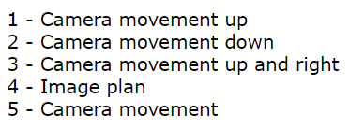
Camera - Electronic Image Stabilization (EIS) (2/2)
How EIS work?

Slide 22
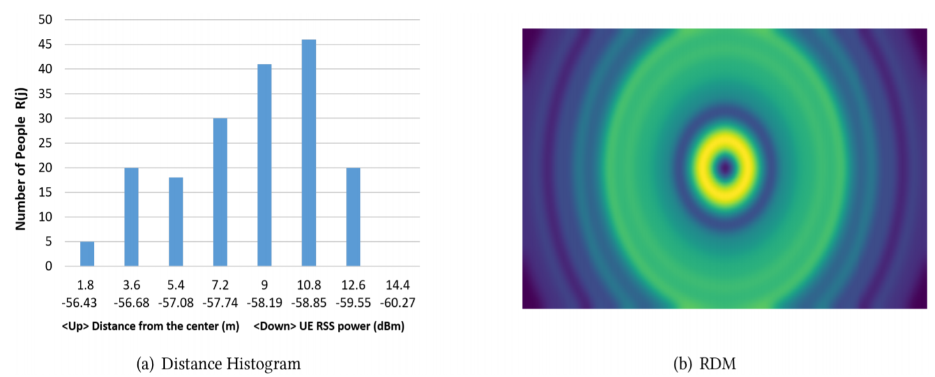
AI Algorithms - Crowd Density Recognition (1/3)
Combined both RGB image and received signal strength (RSS)
To deal with the low quality images, such as occlusion, or poor light condition
Received signal strength (RSS)
A measurement of the power in a received radio signal
It can be measures from each received packet in the MAC layer
It can be described how far a person is from the UAV
The original RSS is transform into the human density map (RDM)

Slide 23
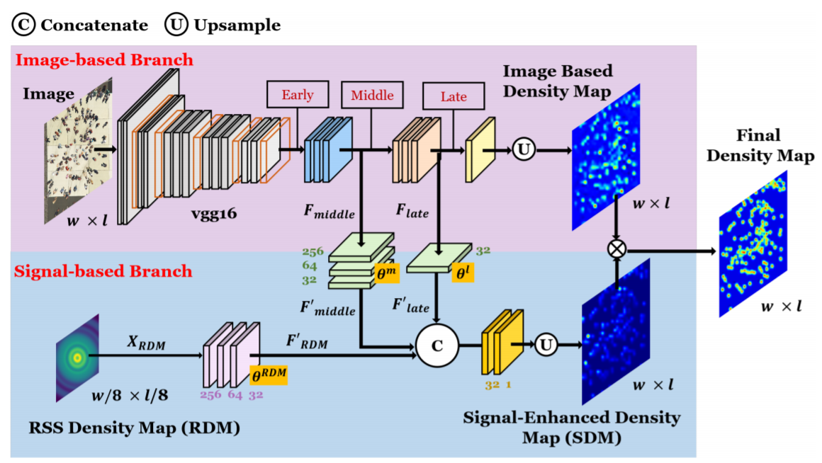
AI Algorithms - Crowd Density Recognition (2/3)
The model (RIFNet) has been divided into two branch
The image-based branch and the signal-based branch
The overall architecture

Slide 24
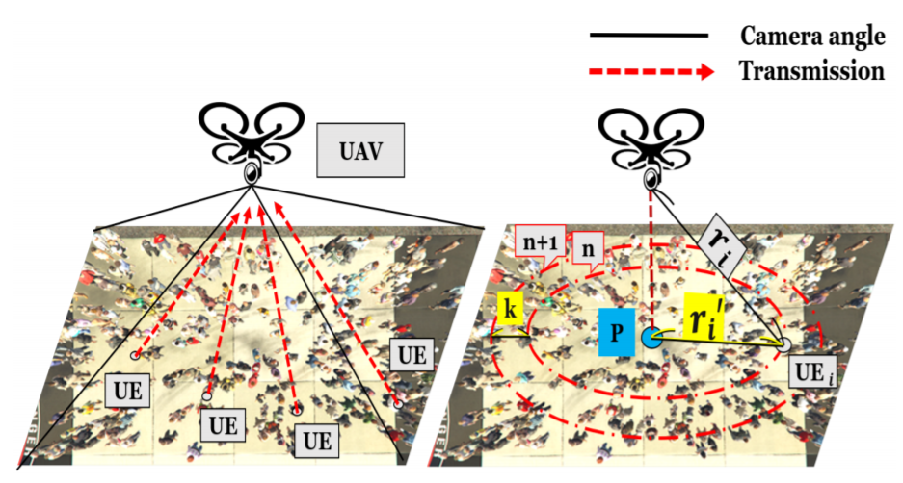
AI Algorithms - Crowd Density Recognition (3/3)
The performance of RIFNet is better than the state-of-the-art methods
The scenario is as follows:
After obtain the crowd density
We set a threshold to decide whether the density is overloaded or not to prevent a crowd crush

Slide 25
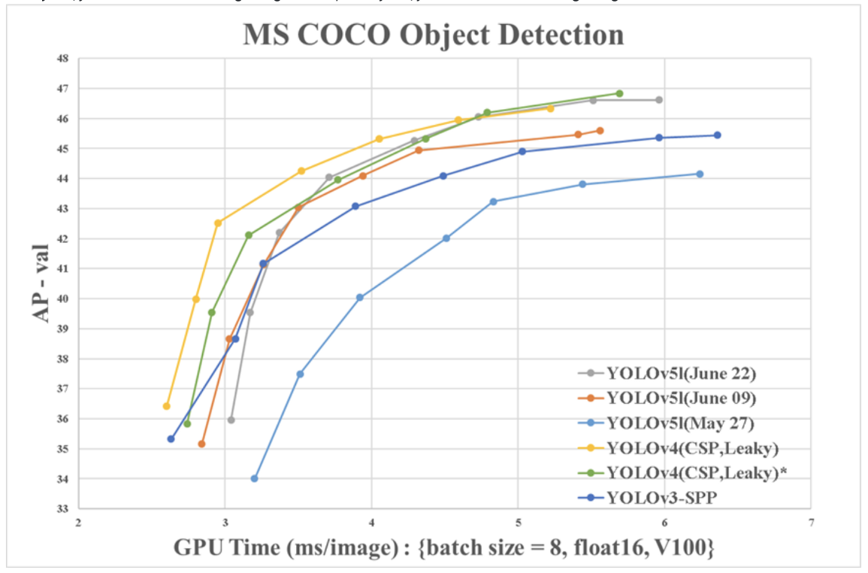
AI Algorithms - Traffic Analysis (1/2)
The system can analyze the traffic
Based on the video captured by drone and deep learning method
We adopt the You Look Only Once version 5 (YOLOv5) model
To deal with the object detection task
It identifies objects more rapidly and more precisely than other recognition systems

Slide 26
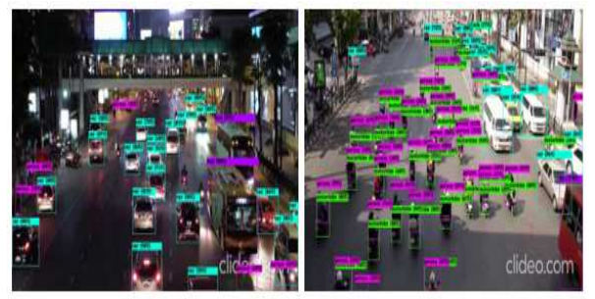
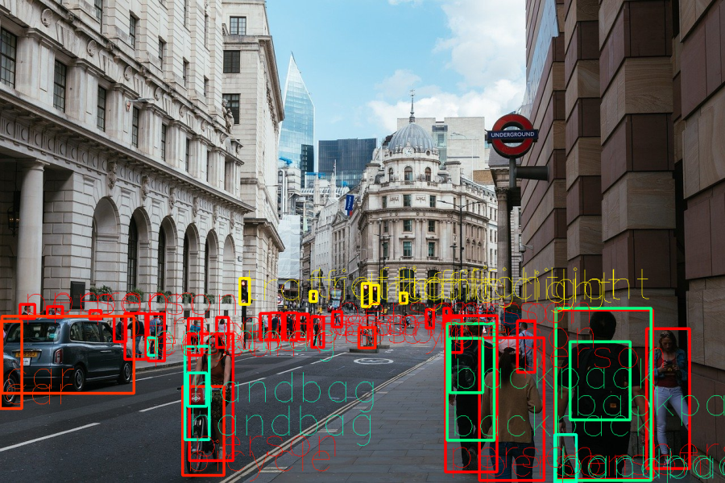
AI Algorithms - Traffic Analysis (2/2)
We estimate the speed of each object from the object detection results
If several objects’ speed is lower than a threshold, a traffic jam may occur
Adjust the duration of the traffic light

Slide 27
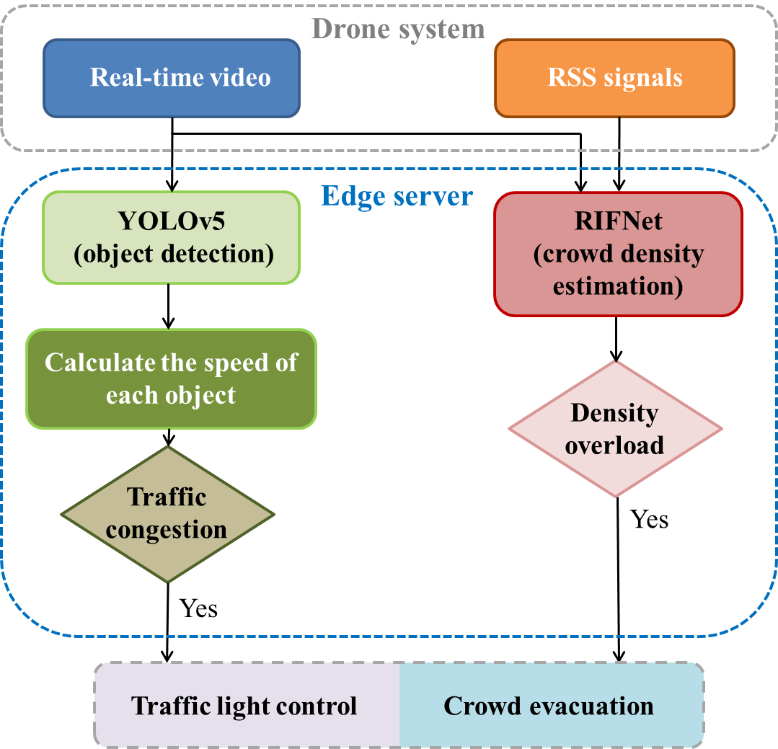
Processing Flow

Slide 28
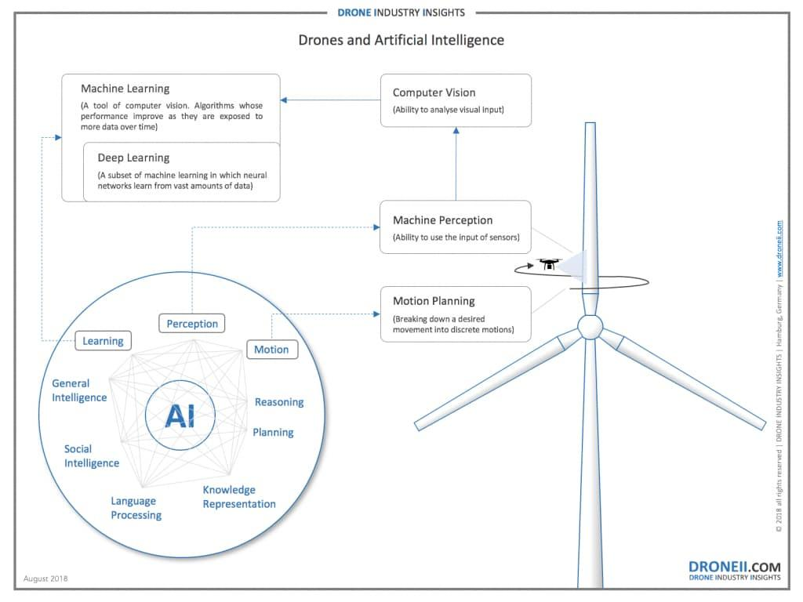
AI Algorithms - Drone Management (1/3)
The advantages of AI-based autonomous drone
The system is cheaper and safer since no human error

Slide 29
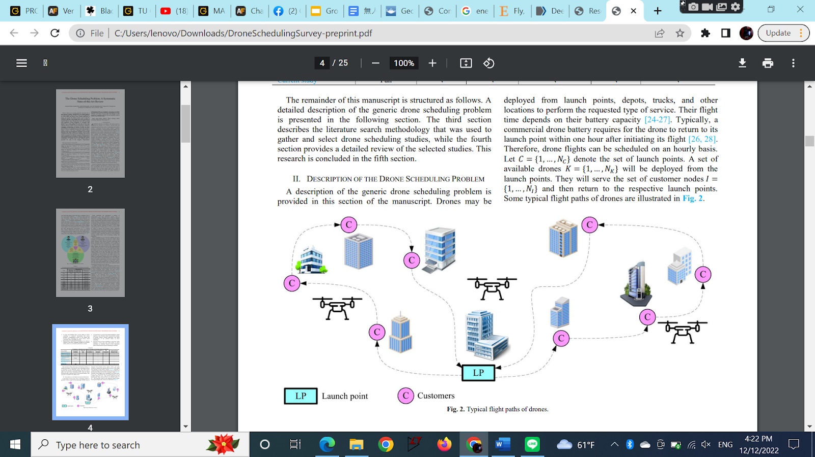
AI Algorithms - Drone Management (2/3)
AI-powered flight controller
An AI-powered flight controller is necessary that has the right types of sensor
Capable of following a preprogrammed flight path and therefore perfect for autonomous navigation
Positioning system
Depend on our GPS and vision-based methods
Path planning for multi-drone system
By considering several information
Battery recharge time
Battery capacity
Arrival time at each node
Position
Crowd density
Objectives of other drones

Slide 30
AI Algorithms - Drone Management (3/3)
General Drone Scheduling Problem (GDSP)
One of the key problems that have received increasing attention over the last decade
Associate with several features
Such as launch points, nodes, objectives, monitoring, and battery capacities
Under the limited amount of the flying time
The drone is designed to served the designated customers and return the launch point
We plan to use GDSP to help with the task of calculating flight paths
GDSP is basically a set of rules and constraints
That make sure the path planning is in the most optimized way

Slide 31
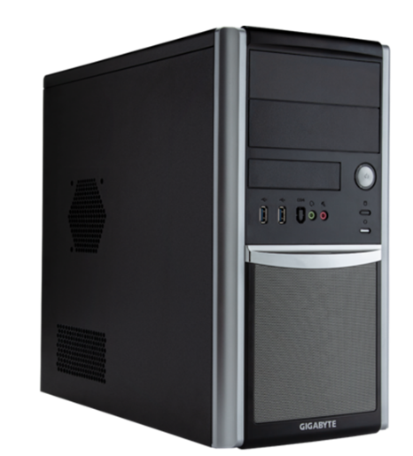
Edge Server
The AI algorithms is computed by the edge server
Upgraded from W332-Z00 AMD Ryzen™ Tower Entry Workstation
Specification
Motherboard | MC13-NB0
Memory | 256gb DDR5
CPU | AMD EPYC™ 9004
GPU | NVIDIA A100 40/80GB PCIe GPU
Power Supply | Cosair AX1600i

Slide 32
Outline
Introduction
System Architecture
Specification and Technology Analysis
Drone system
Camera - Electronic Image Stabilization (EIS)
AI algorithm
Edge server
Industrial Analysis
Porter’s 5 force analysis
S.W.O.T analysis
Conclusion
Task Partition
References

Slide 33
Porter’s 5 Force Analysis
Bargaining power of customers
Low, our product is very innovative and is specifically designed for use by the police.
Bargaining power of suppliers
High, many patents or technologies are only offered by a single manufacturer.
Threat of new entrants
Low, our product is mainly designed for the police and is not easily accessible for the general public to purchase.
Threat of substitutes
Low, our product is designed by combining the technologies and patents of different manufacturers and is mainly for use by the police.
Competitive rivalry
None, there are no competitors in the market.

Slide 34
S.W.O.T Analysis
Strength
Product is unique
Applications such as Sim4live Records first been used on evacuation
A variety of option for different scenarios (speaker, projector, and LED)
Weakness
Only suitable for the police
Expensive
Opportunities
The product can be sold to police in other countries
Military surveillance applications
Rent to the organizer of big event
Threat
Privacy and security issues
DJI rescue services

Slide 35
Outline
Introduction
System Architecture
Specification and Technology Analysis
Drone system
Camera - Electronic Image Stabilization (EIS)
AI algorithm
Edge server
Industrial Analysis
Porter’s 5 force analysis
S.W.O.T analysis
Conclusion
Task Partition
References

Slide 36
Conclusion
In this work, we propose a drone-aided police control system to assist the police task
The system provides a way to evacuate the crowd when an emergency occurs
It broadcast the alert by speaker, projector, etc.
Everyone can notice the alert from the sky and the crowd can be evacuated with a more clear instruction
The system also provide a traffic analysis in real-time
Control the traffic light when a traffic jam is appear
The industrial analysis shows the novelty of the proposed system
The weight of the drone and the battery life is the points that can improve in the future

Slide 37
Task Partition
Proposal - All
SoC specification - 許芷毓
Technology analysis
Drone - 陳俊翰
Camera - 楊士緯
LED, projector, speaker - 楊智勝
Edge server - 郭義安、陳俊翰
5G communication - 許芷毓
Drone management and path planning algorithm - 郭義安
Monitoring system (crowd density) and traffic analysis algorithm - 楊士緯
Industrial analysis - 楊智勝
Organize report - 楊智勝、許芷毓
Presentation - 楊士緯、郭義安、陳俊翰
Note that the task partition is described with more detail in the final report

Slide 38
References (1/4)
Wikipedia-Seoul Halloween crowd crush https://en.wikipedia.org/wiki/Seoul_Halloween_crowd_crush
CNN-‘Somebody is going to die’: How Seoul’s deadly Halloween crush unfolded. https://edition.cnn.com/2022/11/04/asia/itaewon-seoul-korea-halloween-crush-timeline-intl-hnk-dst/index.html
156 die in Halloween crowd crush in Korea's Itaewon https://koreajoongangdaily.joins.com/2022/10/30/national/socialAffairs/Korea/20221030191108962.html
Camera https://www.allaboutcircuits.com/technical-articles/introduction-to-cmos-image-sensors/ https://www.dronescend.co.uk/blogs/news/electronic-image-stabilisation
Introduction to RSS: https://info-nrlte.com/2021/05/09/an-introduction-to-csi-rs/
RIFNet: Kai-Wei Yang, Yen-Yun Huang, Jen-Wei Huang, Ya-Rou Hsu, Chang-Lin Wan, Hong-Han Shuai, Li-Chun Wang, and Wen-Huang Cheng. 2022. Improving Crowd Density Estimation by Fusing Aerial Images and Radio Signals. ACM Trans. Multimedia Comput. Commun. Appl. 18, 3, Article 84 (August 2022), 23 pages.
Traffic analysis: H. Zhang, M. Liptrott, N. Bessis and J. Cheng, "Real-Time Traffic Analysis using Deep Learning Techniques and UAV based Video," 2019 16th IEEE International Conference on Advanced Video and Signal Based Surveillance (AVSS), 2019, pp. 1-5.
YOLOv5: https://blog.roboflow.com/yolov5-improvements-and-evaluation/ https://www.researchgate.net/figure/YOLOv4-Tiny-network-architecture-based-on-CSPDarknet53-Tiny-backbone-and-CSPBlocks_fig2_360985952
https://pedin024.medium.com/初探yolov5-71f13b4ba78d
論無人機商用服務與整合技術 http://www.cie.org.tw/cms/JournalFiles/10912_chapter07.pdf

Slide 39
References (2/4)
Qualcomm® QRB5165 SoC for IoT Product Brief https://www.qualcomm.com/content/dam/qcomm-martech/dm-assets/documents/qrb5165-soc-product-brief_87-28730-1-b.pdf
Qualcomm’s latest drone platform features 5G and seven cameras https://linuxgizmos.com/qualcomms-latest-drone-platform-features-5g-and-seven-cameras/
Qualcomm-5G https://www.qualcomm.com/5g/what-is-5g#:~:text=Q%3A%20What%20is%205G%3F,machines%2C%20objects%2C%20and%20devices.
Wikipedia-5G https://en.wikipedia.org/wiki/5G
Digi: Comparison between 4G vs 5G https://www.malaysiainternet.my/2019/04/digi-comparison-between-4g-vs-5g/
EMF-5G EXPLAINED - HOW 5G WORKS https://www.emfexplained.info/?ID=25916#How%20does%205G%20work
LITEPOINT- An Introduction to the 5G Small Cell https://www.litepoint.com/blog/an-introduction-to-the-5g-small-cell/
iThome- 9個QA快速認識5G https://www.ithome.com.tw/news/138745
消防署） 「警消微波網路系統移頻計畫」 - 行政院 https://www.google.com/url?sa=i&rct=j&q=&esrc=s&source=web&cd=&ved=0CAMQw7AJahcKEwiws_Wj0aj8AhUAAAAAHQAAAAAQBQ&url=https%3A%2F%2Fwww.ey.gov.tw%2FFile%2F214A16AB14520C65&psig=AOvVaw3ir4H7r7mptTubitMzeUD9&ust=1672740280890298
MediaTek Dimensity 9200 with TSMC N4P, Arm Cortex-X3, and ray tracing is now released https://technewsrooms.com/mediatek-dimensity-9200-released/

Slide 40
References (3/4)
Chipset for Incredible Performance and Unmatched Power Savings https://corp.mediatek.com/news-events/press-releases/mediatek-launches-flagship-dimensity-9200-chipset-for-incredible-performance-and-unmatched-power-savings
Wikipedia-Mobile cell sites https://en.wikipedia.org/wiki/Mobile_cell_sites
Youube-行動基地台車是什麼原理？直擊中央公園跨年現場！五大電信訊務擴充部署情形 & 4G/5G測速 https://www.youtube.com/watch?v=Q6J-I_E-uf8&ab_channel=%E6%84%9B%E8%93%81AiZhen
When COWs Fly: AT&T Sending LTE Signals from Drones https://about.att.com/innovationblog/cows_fly
How cell tower 'COW' drones will keep fans safe at the Super Bowl https://www.zdnet.com/home-and-office/networking/how-cell-tower-cow-drones-will-keep-fans-safe-at-the-super-bowl/
緊急空中基地台系統 https://www.taiwanexcellence.org/tw/award/product/109423
YouTube-【中華電信 + 雷虎科技】緊急空中基地台系統 Flying Mobile Base Station for Emergency Recovery https://www.youtube.com/watch?v=izmbLGrBWTk&ab_channel=ThunderTiger%E9%9B%B7%E8%99%8E%E7%A7%91%E6%8A%80
http://www.simp4live.com/projection-mapping-big/body-projection-mapping-vj-4hkbd
https://shopee.tw/DJI大疆御-Mavic-air-2-mini-2-pro爆閃燈-phantom精靈4夜航燈-閃光燈-10w警示燈-i.307929595.8605216889
https://urbenq.com/2016/08/12/google%e6%96%b0%e5%b0%88%e5%88%a9%ef%bc%9a%e7%94%a8%e7%84%a1%e4%ba%ba%e6%a9%9f%e6%90%ad%e8%9e%a2%e5%b9%95%e3%80%81%e6%8a%95%e5%bd%b1%e6%a9%9f%e4%be%86%e9%96%8b%e8%a6%96%e8%a8%8a%e6%9c%83%e8%ad%b0/

Slide 41
References (4/4)
https://patents.google.com/patent/AU2016226595B2/en
https://elitescreens.com/products/yard-master-electric-series/
https://www.alibaba.com/product-detail/Global-Drone-Speaker-Portable-Drone-Megaphone_62558745815.html
https://zh.wikipedia.org/zh-tw/Bayraktar_TB2
https://zh.m.wikipedia.org/zh-tw/無人機表演
https://www.grandviewresearch.com/industry-analysis/consumer-drone-market

Slide 42
Thank You!

